Slide 1



NAME –
Vansh Kumar Thakur
COURSE –
M.SC DATA SCIENCE.
SEMESTER –
I st
Dr. Aashima Bangia
Assistant professor, School of Data Science Department, AAFT
University

Slide 2



DATA SUMMARIZATION

Slide 3



















D
Mean
A
T
Measures of
A
Mode
Central tendency
S
U
Median
M
M
A
Range
R
I
Z
Variance
A
Measures of
T
Dispersion
Standard
I
O
deviation
N
Coefficient of
variation

Slide 4









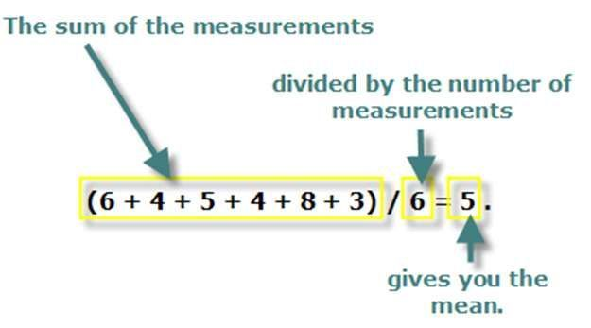
ARITHMETIC MEAN
Sum of observation divided by the number of observations.
x = mean
∑ denotes the (sum of)
x the values of observation
n the number of observation

Slide 5


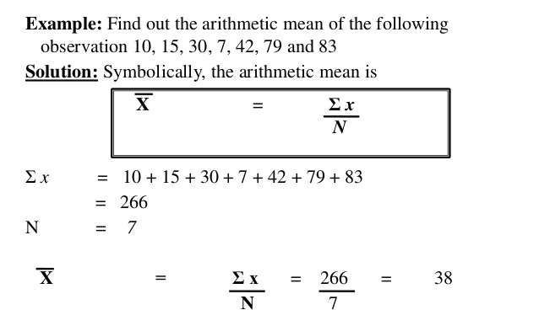
ARITHMETIC MEAN

Slide 6






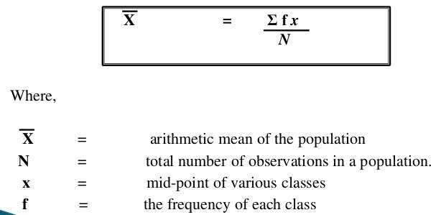
ARITHMETIC MEAN
In case of frequency distribution data we calculate the
mean by this equation:

Slide 7


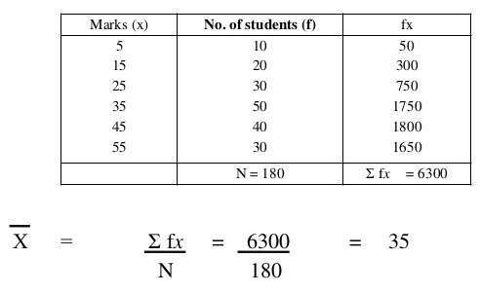
ARITHMETIC MEAN

Slide 8




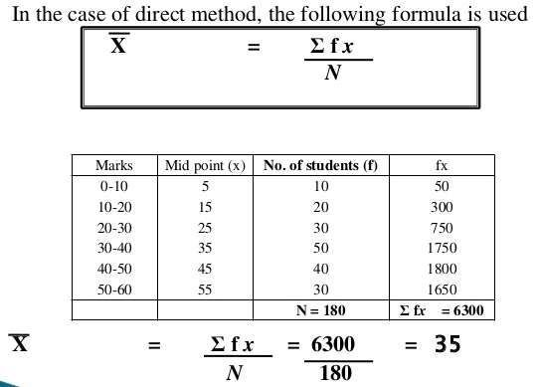
▪
If data is presented in frequency table with class intervals
we calculate mean by
the
same equation but using
the
midpoint of class interval.

Slide 9
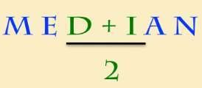









MEDIAN
▪ The middle observation
in a series of observation
after
arranging
them
in
an
ascending
or
descending manner
Rank of median
Odd no.
Even no.
(n + 1)/2
(n + 1)/2
n/2

Slide 10
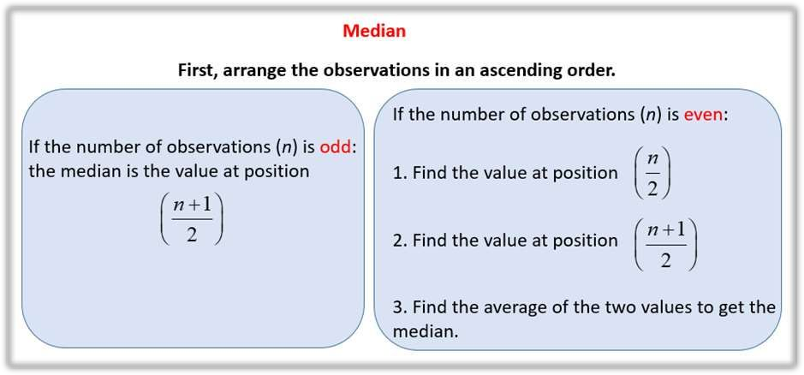
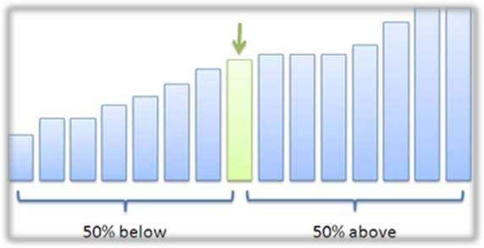

Slide 11

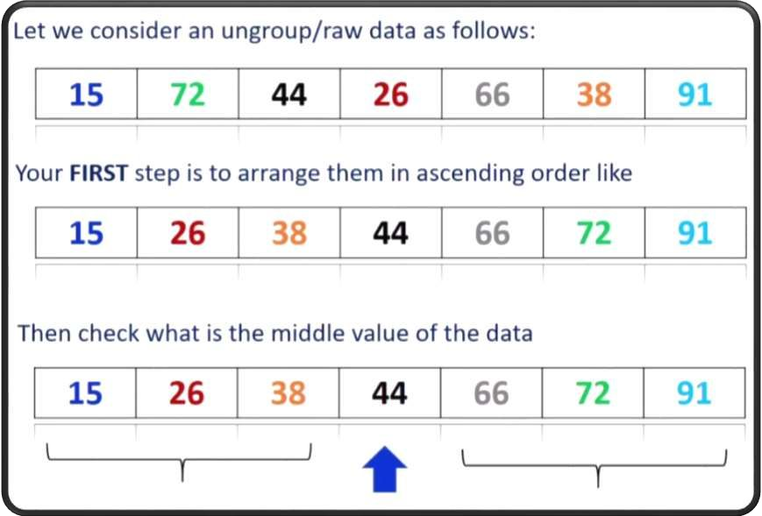
MEDIAN

Slide 12
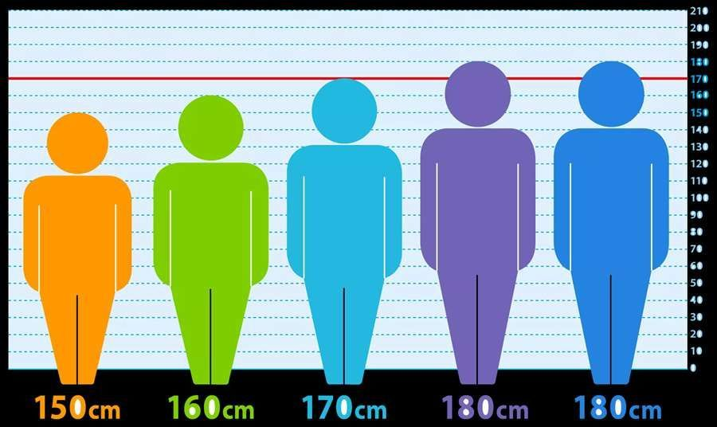
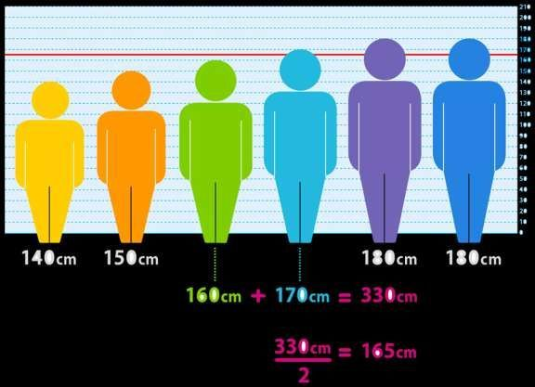

Slide 13


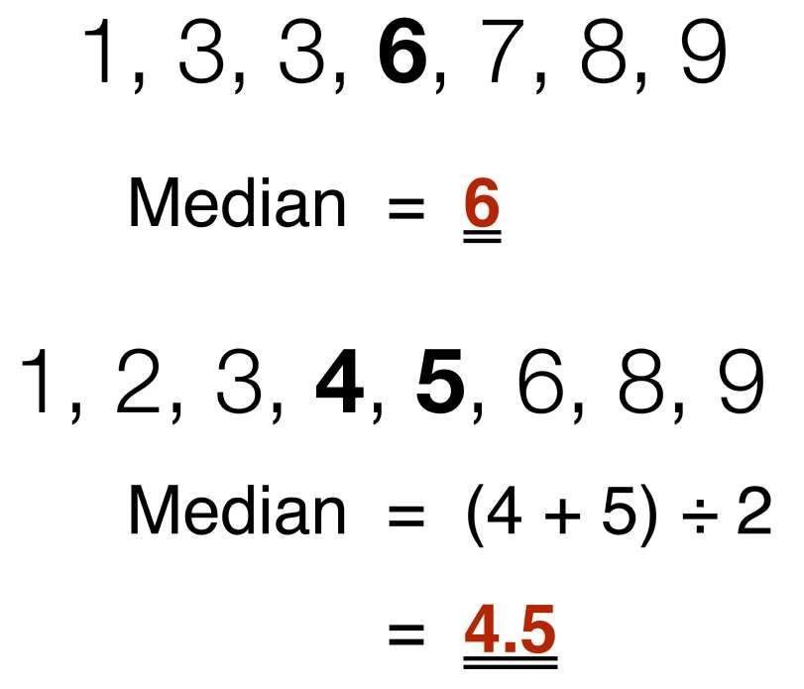
MEDIAN

Slide 14
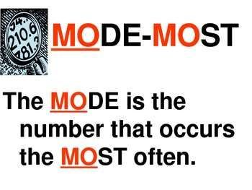





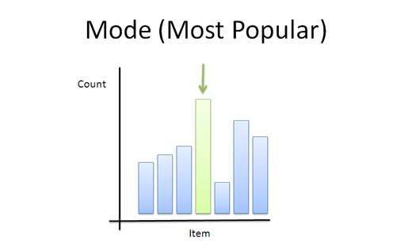
MODE
The most frequent occurring value in the data.

Slide 15
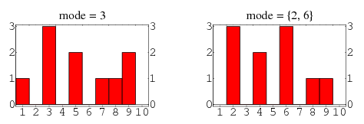
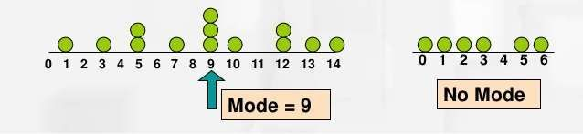
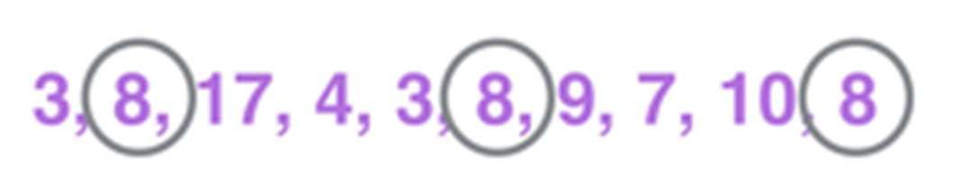
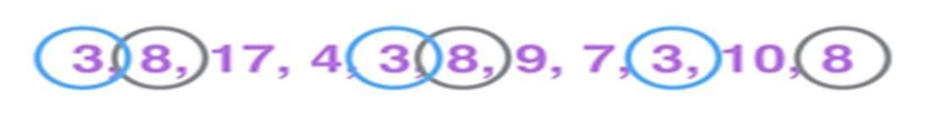

Slide 16


















ADVANTAGES & DISADVANTAGES OF THE
MEASURES OF CENTRAL TENDENCY:
• Usually
preferred
since
it
takes
into
account
each
individual
observation
• Main disadvantage
is
that
it
is affected by
the value of extreme
Mean
observations.
• Useful
descriptive measure
if
there
are
one
or
two
extremely high or low values.
Median
• Seldom used.
Mode

Slide 17
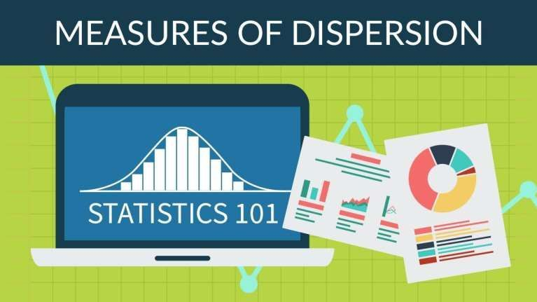

Slide 18




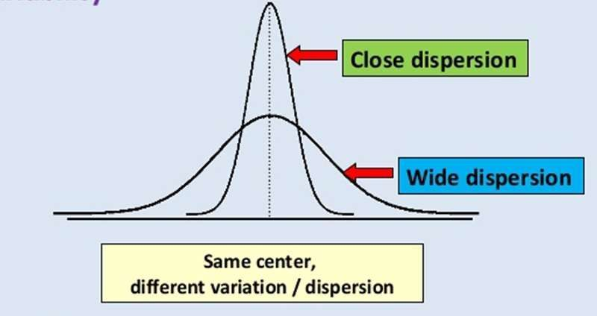
MEASURE OF DISPERSION
Describes the degree of variations or scatter or
dispersion of the data around its central values
(dispersion = variation = spread = scatter).

Slide 19












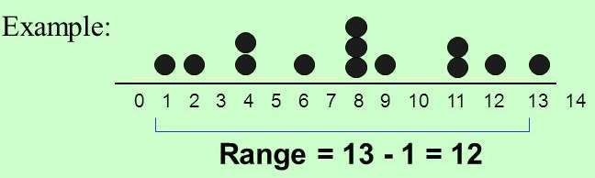
RANGE
➢ The difference between the largest & smallest values.
➢
It is the simplest measure of variation
It can be expressed as an
interval such as 4-10, where 4
is
the smallest value & 10 is highest.
But often,
it
is expressed as
interval width. For example,
the range of 4-10 can also be expressed as a range of 6.

Slide 20



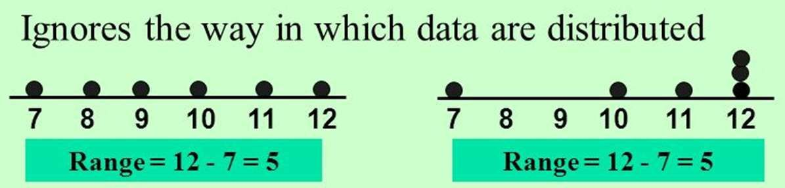


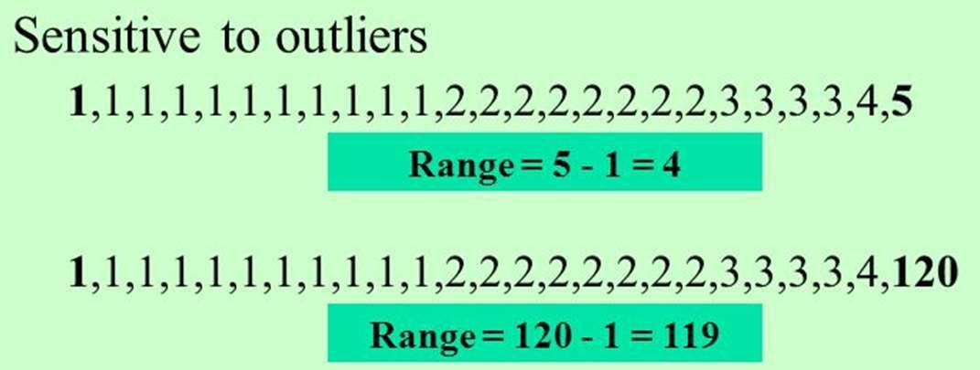
RANGE
Disadvantages:

Slide 21

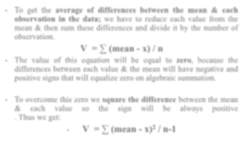



VARIANCE
•
To
get
the
average
of differences between
the mean &
each
observation
in
the data; we have
to
reduce each value
from
the
mean &
then sum
these differences and divide
it by
the number of
observation.
V = ∑ (mean - x) / n
•
The
value
of
this
equation will
be
equal
to
zero,
because
the
differences between each value &
the mean will have negative and
positive signs that will equalize zero on algebraic summation.
•
To overcome
this zero we square the difference between
the mean
&
each
value
so
the
sign
will
be
always
positive
. Thus we get:
2
•
V = ∑ (mean - x)
/ n-1

Slide 22



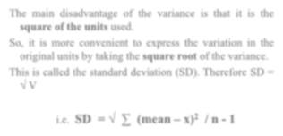



STANDARD DEVIATION “SD”
The main disadvantage of
the variance
is
that
it
is
the
square of the units used.
So,
it
is more convenient
to express
the variation
in
the
original units by taking the square root of the variance.
This
is called
the standard deviation (SD). Therefore SD =
√ V
2
i.e. SD = √ ∑ (mean – x)
/ n - 1

Slide 23
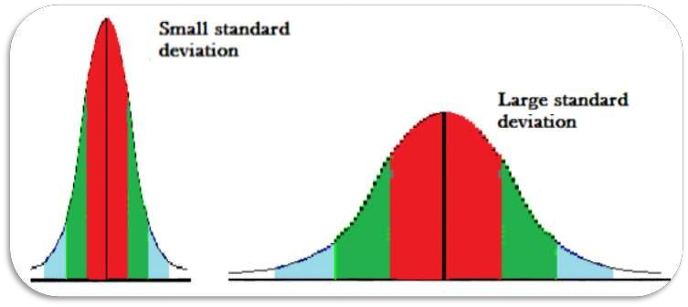
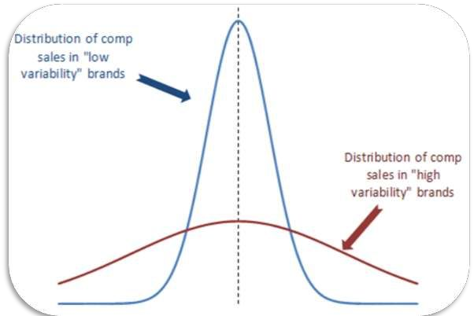

Slide 24
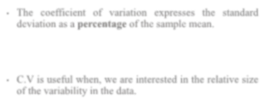






COEFFICIENT OF VARIATION “COV”
•
The
coefficient
of
variation
expresses
the
standard
deviation as a percentage of the sample mean.
•
C.V is useful when, we are
interested
in
the relative size
of the variability in the data.

Slide 25


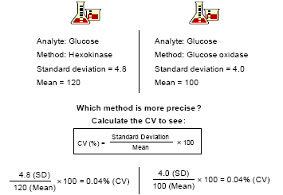

Slide 26


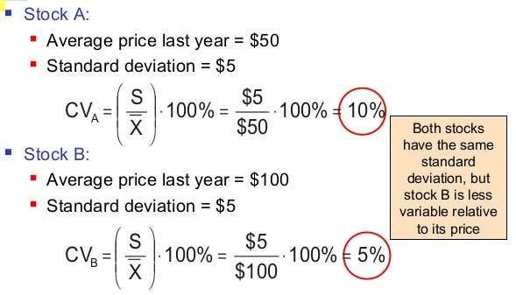

Slide 27
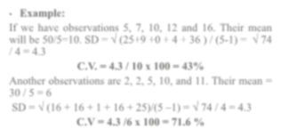





•
Example:
If we have observations 5, 7, 10, 12 and 16. Their mean
will be 50/5=10. SD = √ (25+9 +0 + 4 + 36 ) / (5-1) = √ 74
/ 4 = 4.3
C.V. = 4.3 / 10 x 100 = 43%
Another observations are 2, 2, 5, 10, and 11. Their mean =
30 / 5 = 6
SD = √ (16 + 16 + 1 + 16 + 25)/(5 –1) = √ 74 / 4 = 4.3
C.V = 4.3 /6 x 100 = 71.6 %
Both observations have
the same SD but
they are different
st group
in C.V. because data
in
the 1
is homogenous
(so
C.V.
is
not
high), while
data
in
the
nd
2
observations
is
heterogeneous (so C.V.
is high).

Slide 28


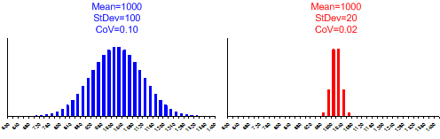

Slide 29




















•
Example:
In
a
study where
age was
recorded
the
following were the observed values: 6, 8, 9, 7, 6. and the
number of observations were 5.
•
Calculate the mean, SD and range, mode and median.
Mean = (6 + 8 + 9 + 7 + 6) / 5 = 7.2
Median = 7
Mode= 6
Range = 9 – 6 = 3
Variance = (7.2-6)2 + (7.2-8)2 + (7.2-9)2 + (7.2-7)2 + (7.2-
6)2 / 5-1 = (1.2)2 + (- 0.8)2 + (-1.8) 2 +(0.2)2 + (1.2)2 / 4 =
1.7
S.D. = √ 1.7 = 1.3

Slide 30



